Slide 2
Topics
Basic String Operations
String Slicing
Testing, Searching, and Manipulating Strings

Slide 3
Basic String Operations
Many types of programs perform operations on strings
In Python, many tools for examining and manipulating strings
  Strings are sequences, so many of the tools that work with sequences work with strings

Slide 4
String Data Type
>>> str1 = "Hello"
>>> str2 = 'there'
>>> bob = str1 + str2
>>> print(bob)
Hellothere
>>> str3 = '123'
>>> str3 = str3 + 1
Traceback (most recent call last): File "<stdin>", line 1, in <module>
TypeError: cannot concatenate 'str' and 'int' objects
>>> x = int(str3) + 1
>>> print(x)
124
>>>
A string is a sequence of characters
A string literal uses quotes
'Hello' or "Hello"
For strings, + means “concatenate”
When a string contains numbers, it is still a string
We can convert numbers in a string into a number using int()

Slide 5
Reading and Converting
>>> name = input('Enter:')
Enter:Chuck
>>> print(name)
Chuck
>>> apple = input('Enter:')
Enter:100
>>> x = apple – 10
Traceback (most recent call last): File "<stdin>", line 1, in <module>
TypeError: unsupported operand type(s) for -: 'str' and 'int'
>>> x = int(apple) – 10
>>> print(x)
90
We prefer to read data in using strings and then parse and convert the data as we need
This gives us more control over error situations and/or bad user input
Input numbers must be converted from strings

Slide 6
Accessing the Individual Characters in a String
To access an individual character in a string:
  Use a for loop
    Format: for character in string:
    Useful when need to iterate over the whole string, such as to count the occurrences of a specific character
  Use indexing
    Each character has an index specifying its position in the string, starting at 0
    Format: character = my_string[i]

Slide 7
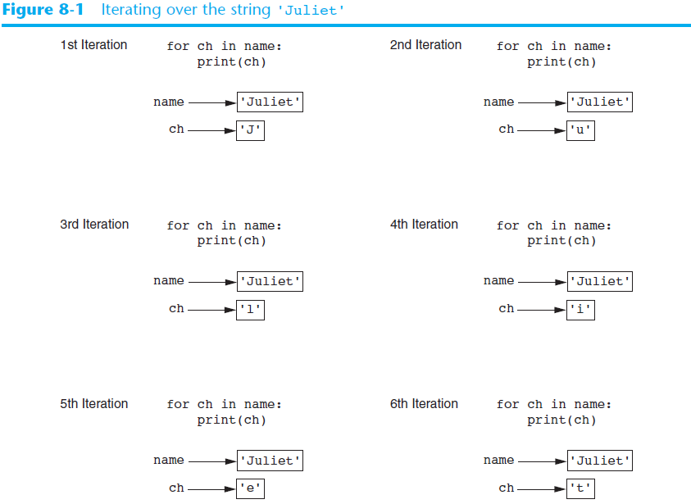

Slide 8
Looping Through Strings
Using a while statement, an iteration variable, and the len function, we can construct a loop to look at each of the letters in a string individually
0 b
1 a
2 n
3 a
4 n
5 a
fruit = 'banana'
index = 0
while index < len(fruit):
letter = fruit[index]
print(index, letter)
index = index + 1

Slide 9
Looping Through Strings
A definite loop using a for statement is much more elegant
The iteration variable is completely taken care of by the for loop
fruit = 'banana'
for letter in fruit:
print(letter)
b
a
n
a
n
a

Slide 10
Looping Through Strings
A definite loop using a for statement is much more elegant
The iteration variable is completely taken care of by the for loop
fruit = 'banana'
for letter in fruit:
print(letter)
b
a
n
a
n
a
index = 0
while index < len(fruit):
letter = fruit[index]
print(letter)
index = index + 1

Slide 11
Looping and Counting
This is a simple loop that loops through each letter in a string and counts the number of times the loop encounters the 'a' character
word = 'banana'
count = 0
for letter in word :
if letter == 'a' :
count = count + 1
print(count)

Slide 12
Looking Deeper into in
The iteration variable “iterates” through the sequence (ordered set)
The block (body) of code is executed once for each value in the sequence
The iteration variable moves through all of the values in the sequence
Iteration variable
Six-character string
for letter in 'banana':
print(letter)

Slide 13
Yes
Done?
No
Advance letter
b
a
n
a
n
a
print(letter)
for letter in 'banana':
print(letter)
The iteration variable “iterates” through the string and the block (body) of code is executed once for each value in the sequence

Slide 14
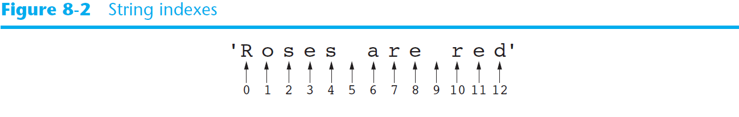
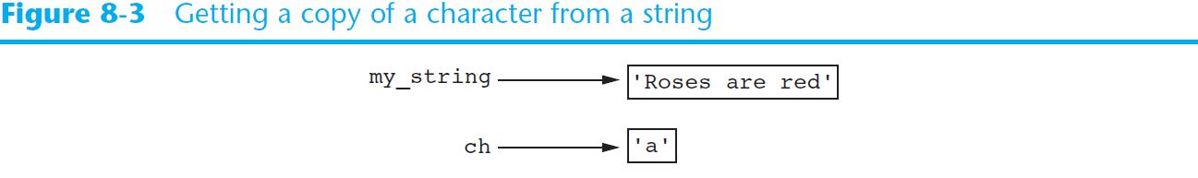
Accessing the Individual Characters in a String (cont’d.)

Slide 15
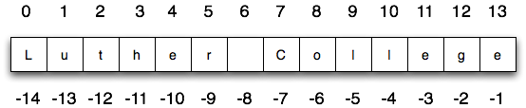
Characters of a String
school = "Luther College"
m = school[2]
print(m)
lastchar = school[-1]
print(lastchar)

Slide 16
What is printed by the following statements?
s = "python rocks"
print(s[2] + s[-4])
A. tr
B. to
C. ps
D. nn
E. Error, you cannot use the [ ] operator with the + operator.

Slide 17

Accessing the Individual Characters in a String (cont’d.)
IndexError exception will occur if:
  You try to use an index that is out of range for the string
    Likely to happen when loop iterates beyond the end of the string
len(string) function can be used to obtain the length of a string
  Useful to prevent loops from iterating beyond the end of a string

Slide 18
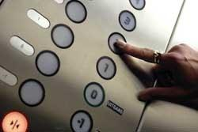
Looking Inside Strings
We can get at any single character in a string using an index specified in square brackets
The index value must be an integer and starts at zero
The index value can be an expression that is computed
b
a
n
a
n
a
0
1
2
3
4
5
>>> fruit = 'banana'
>>> letter = fruit[1]
>>> print(letter)
a
>>> x = 3
>>> w = fruit[x - 1]
>>> print(w)
n

Slide 19
A Character Too Far
You will get a python error if you attempt to index beyond the end of a string
So be careful when constructing index values and slices
>>> zot = 'abc'
>>> print(zot[5])
Traceback (most recent call last): File "<stdin>", line 1, in <module>
IndexError: string index out of range
>>>

Slide 20
String Functions
Length len()
  fruit = "Banana"
  print(len(fruit))
  size = len(fruit)
  last = fruit[size] # ERROR!
  print(last)
  message = "Hello World"
  print(len(message))
  newMessage_2 = message[len(message)-1:len(message)]
  print(newMessage_2)

Slide 21
What is printed by the following statements?
s = "python rocks"
print(len(s))
A. 11
B. 12
C. 13
D. 14

Slide 22
Strings Have Length
b
a
n
a
n
a
The built-in function len gives us the length of a string
0
1
2
3
4
5
>>> fruit = 'banana'
>>> print(len(fruit))
6

Slide 23
len Function
>>> fruit = 'banana'
>>> x = len(fruit)
>>> print(x)
6
A function is some stored code that we use. A function takes some input and produces an output.
len()
function
'banana'
(a string)
6
(a number)

Slide 24
len Function
>>> fruit = 'banana'
>>> x = len(fruit)
>>> print(x)
6
A function is some stored code that we use. A function takes some input and produces an output.
def len(inp):
blah
blah
for x in y:
blah
blah
'banana'
(a string)
6
(a number)

Slide 25
String Concatenation
Concatenation: appending one string to the end of another string
  Use the + operator to produce a string that is a combination of its operands
  The augmented assignment operator += can also be used to concatenate strings
    The operand on the left side of the += operator must be an existing variable; otherwise, an exception is raised

Slide 26
Strings
The computer can also compute with words, or more accurately, with strings which are sequences of characters.
We can create a string by typing characters between a pair of single ('Hi'), double ("Hi"), or triple quotes ("'Hi'").
We generate silly song lyrics by using + to combine (append) two strings and * to repeat strings.

Slide 27
String Example
>>> a = """This string spans over two lines,
and contains 'single quotes', "double quotes" and
'''triple quotes'''"""
>>> print(a)
This string spans over two lines,
and contains 'single quotes', "double quotes" and
'''triple quotes'''
>>> print("alpha\nbeta\tgamma")
alpha
beta gamma
>>> print(r"alfa\nbeta\tgamma")
alfa\nbeta\tgamma
>>> print(r"alfa\nbeta\tgamma") # It's possible to create raw strings (escape characters will not be interpreted)
alfa\nbeta\tgamma

Slide 28
String Example
first = "Steve"
last = "Roger"
fullName = first + " " + last
print(fullName)

Slide 29
String Example
basic = "Ma"
print(basic)
basic3 = basic + basic + basic
print(basic3)
next = "Mow"
next3 = next * 3
print(next3)
together = (basic * 3) + (next * 2)
print(together)
print(together + "Mmm" + together)

Slide 30
String Concatenation
When the + operator is applied to strings, it means “concatenation”
>>> a = 'Hello'
>>> b = a + 'There'
>>> print(b)
HelloThere
>>> c = a + ' ' + 'There'
>>> print(c)
Hello There
>>>

Slide 31
String Example
>>> cihan = "Python"
>>> cihan += ' ' + "rocks!"
>>> cihan = cihan + ' ' + 'ACM' + " 114"
>>> print(cihan)
Python rocks! ACM 114
>>>

Slide 32
Strings Are Immutable
Strings are immutable
  Once they are created, they cannot be changed
    Concatenation doesn’t actually change the existing string, but rather creates a new string and assigns the new string to the previously used variable
  Cannot use an expression of the form
  string[index] = new_character
    Statement of this type will raise an exception

Slide 33
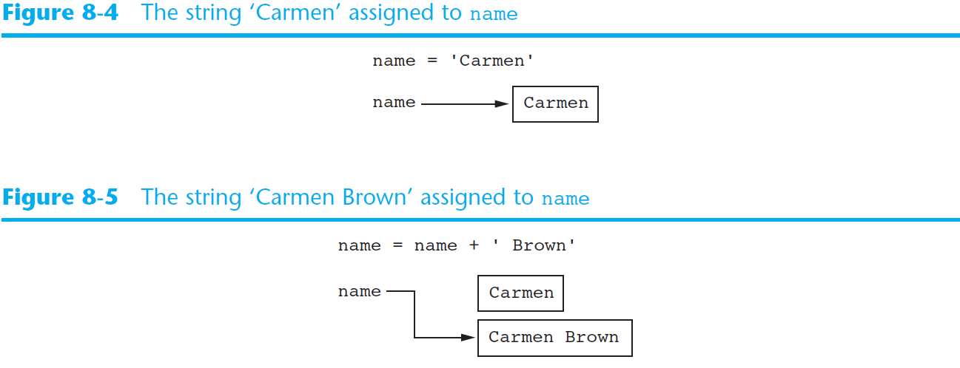
Strings Are Immutable (cont’d.)

Slide 34
String Example
>>> print(cihan)
Python rocks! ACM 114
>>> cihan[7] = 'R'
Traceback (most recent call last):
File "<pyshell#26>", line 1, in <module>
cihan[7] = 'R'
TypeError: 'str' object does not support item assignment
>>> a = cihan.split()
>>> print(a)
['Python', 'rocks!', 'ACM', '114']
>>> a[1][0] = 'R'
Traceback (most recent call last):
File "<pyshell#29>", line 1, in <module>
a[1][0] = 'R'
TypeError: 'str' object does not support item assignment

Slide 35
String Example
>>> b = list(cihan)
>>> print(b)
['P', 'y', 't', 'h', 'o', 'n', ' ', 'r', 'o', 'c', 'k', 's', '!', ' ', 'A', 'C', 'M', ' ', '1', '1', '4']
>>> print(b.index('r'))
7
>>> b[7] = 'R'
>>> print(b)
['P', 'y', 't', 'h', 'o', 'n', ' ', 'R', 'o', 'c', 'k', 's', '!', ' ', 'A', 'C', 'M', ' ', '1', '1', '4']
>>> ali = str(b)
>>> print(ali)
['P', 'y', 't', 'h', 'o', 'n', ' ', 'R', 'o', 'c', 'k', 's', '!', ' ', 'A', 'C', 'M', ' ', '1', '1', '4']
>>> ali = ''.join(b)
>>> print(ali)
Python Rocks! ACM 114
>>>

Slide 36
String Slicing
Slice: span of items taken from a sequence, known as substring
  Slicing format: string[start : end]
    Expression will return a string containing a copy of the characters from start up to, but not including, end
    If start not specified, 0 is used for start index
    If end not specified, len(string) is used for end index
  Slicing expressions can include a step value and negative indexes relative to end of string

Slide 37
String Functions
Substring
  message = "Hello World"
  print(message [2:5])
  newMessage = message[12:13]
  print(newMessage)

Slide 38
Example
fruit = "banana"
print(fruit[:3])
print(fruit[3:])
print(fruit[::2])
a_list = ['a', 'b', 'c', 'd', 'e', 'f']
print(a_list[1:3])
print(a_list[:4])
print(a_list[3:])
print(a_list[:])
print(a_list[-1:-6:-2])

Slide 39
Slicing Strings
We can also look at any continuous section of a string using a colon operator
The second number is one beyond the end of the slice - “up to but not including”
If the second number is beyond the end of the string, it stops at the end
M
o
n
t
y
P
y
t
h
o
n
0
1
2
3
4
5
6
7
8
9
10
11
>>> s = 'Monty Python'
>>> print(s[0:4])
Mont
>>> print(s[6:7])
P
>>> print(s[6:20])
Python

Slide 40
Slicing Strings
If we leave off the first number or the last number of the slice, it is assumed to be the beginning or end of the string respectively
M
o
n
t
y
P
y
t
h
o
n
0
1
2
3
4
5
6
7
8
9
10
11
>>> s = 'Monty Python'
>>> print(s[:2])
Mo
>>> print(s[8:])
thon
>>> print(s[:])
Monty Python

Slide 41
Testing, Searching, and Manipulating Strings
You can use the in operator to determine whether one string is contained in another string
  General format: string1 in string2
    string1 and string2 can be string literals or variables referencing strings
Similarly you can use the not in operator to determine whether one string is not contained in another string

Slide 42
Example
>>> print(cihan)
Python rocks! ACM 114
>>> str_1 = "Python"
>>> str_2 = "111"
>>> str_3 = '!'
>>> print(str_1 in cihan)
True
>>> print(str_2 not in cihan)
True
>>> print(str_3 not in cihan)
False
>>> print(cihan not in cihan)
False

Slide 43
Using in as a Logical Operator
The in keyword can also be used to check to see if one string is “in” another string
The in expression is a logical expression that returns True or False and can be used in an if statement
>>> fruit = 'banana'
>>> 'n' in fruit
True
>>> 'm' in fruit
False
>>> 'nan' in fruit
True
>>> if 'a' in fruit :
... print('Found it!')
...
Found it!
>>>

Slide 44
String Comparison
if word == 'banana':
print('All right, bananas.')
if word < 'banana':
print('Your word,' + word + ', comes before banana.')
elif word > 'banana':
print('Your word,' + word + ', comes after banana.')
else:
print('All right, bananas.')

Slide 45
String Library
Python has a number of string functions which are in the string library
These functions are already built into every string - we invoke them by appending the function to the string variable
These functions do not modify the original string, instead they return a new string that has been altered
>>> greet = 'Hello Bob'
>>> zap = greet.lower()
>>> print(zap)
hello bob
>>> print(greet)
Hello Bob
>>> print('Hi There'.lower())
hi there
>>>

Slide 46
>>> stuff = 'Hello world'
>>> type(stuff)
<class 'str'>
>>> dir(stuff)
['capitalize', 'casefold', 'center', 'count', 'encode', 'endswith', 'expandtabs', 'find', 'format', 'format_map', 'index', 'isalnum', 'isalpha', 'isdecimal', 'isdigit', 'isidentifier', 'islower', 'isnumeric', 'isprintable', 'isspace', 'istitle', 'isupper', 'join', 'ljust', 'lower', 'lstrip', 'maketrans', 'partition', 'replace', 'rfind', 'rindex', 'rjust', 'rpartition', 'rsplit', 'rstrip', 'split', 'splitlines', 'startswith', 'strip', 'swapcase', 'title', 'translate', 'upper', 'zfill']
https://docs.python.org/3/library/stdtypes.html#string-methods

Slide 47
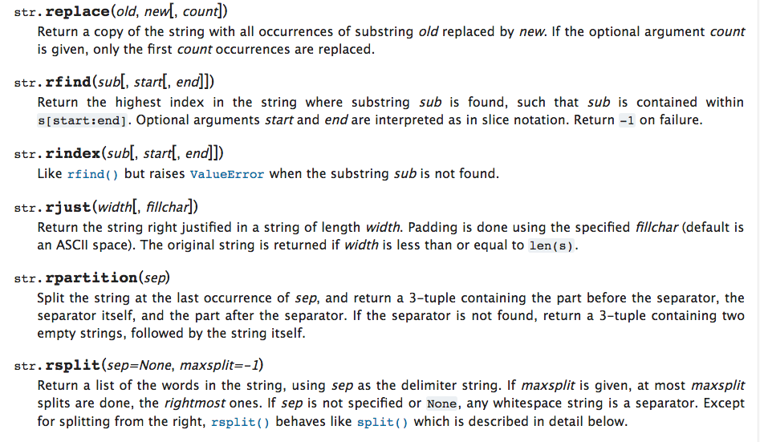

Slide 48
String Library
str.capitalize()
str.center(width[, fillchar])
str.endswith(suffix[, start[, end]])
str.find(sub[, start[, end]])
str.lstrip([chars])
str.replace(old, new[, count])
str.lower()
str.rstrip([chars])
str.strip([chars])
str.upper()

Slide 49
String Methods
Strings in Python have many types of methods, divided into different types of operations
  General format: mystring.method(arguments)
Some methods test a string for specific characteristics
  Generally Boolean methods, that return True if a condition exists, and False otherwise

Slide 50
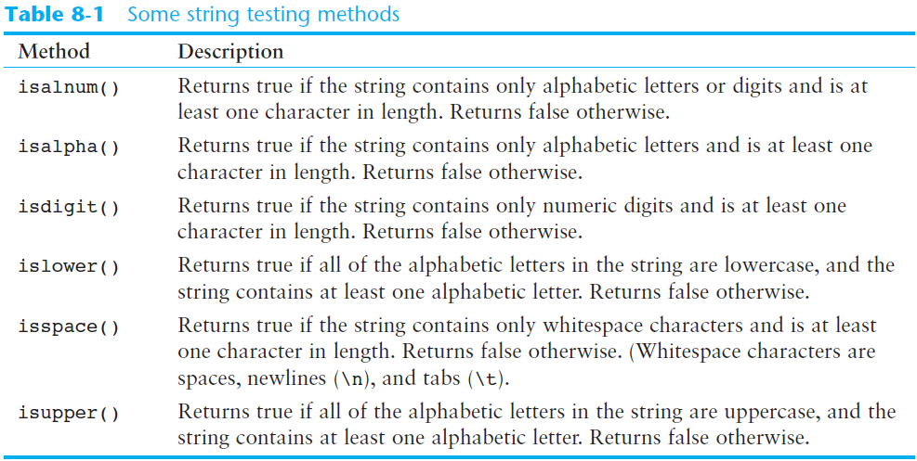
String Methods (cont’d.)

Slide 51
Example
>>> print(cihan)
Python rocks! ACM 114
>>> str_1 = ""
>>> str_2 = "1234"
>>> str_3 = "3.141592"
>>> cihan.isalnum()
False
>>> str_4 = "AMD64"
>>> str_4.isalnum()
True
>>> str_1.isalnum()
False
>>> str_5 = "ACM"
>>> str_5.isalpha()
True
>>> cihan.isalpha()
False
>>> str_4.isalpha()
False
>>> str_1.isalpha()
False
>>> str_3.isdigit()
False
>>> str_2.isdigit()
True
>>> cihan.isdigit()
False
>>> cihan.isspace()
False
>>> str_6 = "\n\t \n \t"
>>> str_6.isspace()
True
>>> cihan.islower()
False
>>> cihan.isupper()
False
>>> str_5.isupper()
True

Slide 52
String Methods (cont’d.)
Some methods return a copy of the string, to which modifications have been made
  Simulate strings as mutable objects
String comparisons are case-sensitive
  Uppercase characters are distinguished from lowercase characters
  lower and upper methods can be used for making case-insensitive string comparisons

Slide 53
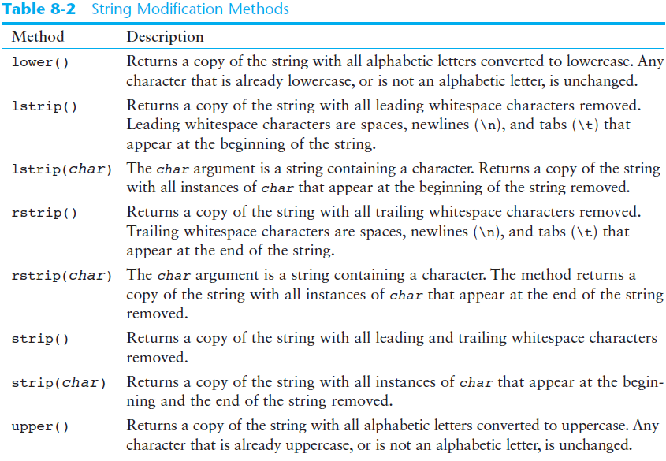
String Methods (cont’d.)

Slide 54
String Functions
Lower()
Upper()
  message = "Hello World"
  print(message.upper())
  print(message.lower())

Slide 55
Example
>>> word = "hello"
>>> word.capitalize()
'Hello'
>>> line = "HELLO WORLD!"
>>> line.lower()
'hello world!'
>>> line = "Hello World!"
>>> line.swapcase()
'hELLO wORLD!'
>>> line = "python is so cool! python rocks!"
>>> line.title()
'Python Is So Cool! Python Rocks!'
>>> line = 'hello world!'
>>> line.upper()
'HELLO WORLD!'

Slide 56
Making everything UPPER CASE
You can make a copy of a string in lower case or upper case
Often when we are searching for a string using find() we first convert the string to lower case so we can search a string regardless of case
>>> greet = 'Hello Cihan'
>>> nnn = greet.upper()
>>> print(nnn)
HELLO CIHAN
>>> www = greet.lower()
>>> print(www)
hello cihan
>>>

Slide 57
Example
>>> string = "Computer"
>>> string.center(20, "*")
'******Computer******'
>>> string.ljust(20, "*")
'Computer************'
>>> string.rjust(20, "*")
'************Computer'
>>> string = "Hello\tWorld!"
>>> string.expandtabs()
'Hello World!'
>>> string = " Computer "
>>> string.lstrip()
'Computer '
>>> string.rstrip()
' Computer'
>>> string.strip()
'Computer'
>>> print(string)
Computer
>>> string = "!!!Hello!!!"
>>> string.lstrip('!')
'Hello!!!'
>>> string.rstrip('!')
'!!!Hello'
>>> string.strip('!')
'Hello'
>>> print(string)
!!!Hello!!!
>>>

Slide 58
Stripping Whitespace
Sometimes we want to take a string and remove whitespace at the beginning and/or end
lstrip() and rstrip() remove whitespace at the left or right
strip() removes both beginning and ending whitespace
>>> greet = ' Hello Bora '
>>> greet.lstrip()
'Hello Bora '
>>> greet.rstrip()
' Hello Bora'
>>> greet.strip()
'Hello Bora'
>>>

Slide 59
String Methods (cont’d.)
Programs commonly need to search for substrings
Several methods to accomplish this:
  endswith(substring): checks if the string ends with substring
    Returns True or False
  startswith(substring): checks if the string starts with substring
    Returns True or False

Slide 60
String Methods (cont’d.)
Several methods to accomplish this (cont’d):
  find(substring): searches for substring within the string
    Returns lowest index of the substring, or if the substring is not contained in the string, returns -1
  replace(substring, new_string):
    Returns a copy of the string where every occurrence of substring is replaced with new_string

Slide 61
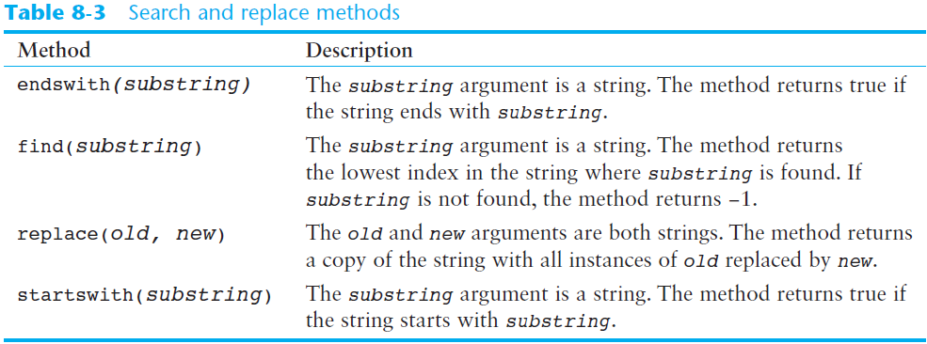
String Methods (cont’d.)

Slide 62
Example
>>> line = "How are you?"
>>> line.endswith('?')
True
>>> line.startswith('How')
True
>>> line.endswith('you?')
True
>>> line.endswith('you')
False
>>> line.startswith("H")
True
>>> line.startswith(' ‘)
False
>>> cihan = 'Python Rocks! ACM 114'
>>> print(cihan)
Python Rocks! ACM 114
>>> cihan.endswith('114')
True
>>> cihan.endswith('ACM 114')
True
>>> cihan.startswith('Python')
True
>>> cihan.startswith('P')
True
>>> cihan.endswith('')
True
>>> cihan.endswith(' ')
False
>>> cihan.startswith('')
True
>>> cihan.startswith('!')
False
>>>

Slide 63
Prefixes
>>> line = 'Please have a nice day'
>>> line.startswith('Please')
True
>>> line.startswith('p')
False

Slide 64
String Functions
Replace ()
  message = "Hello World"
  print(message.replace("o", "ö"))
  print(message)
  print(message.replace("e", "a"))

Slide 65
String Functions
index()
music = "Pull out your music and dancing can begin!"
print(music.index("m"))
print(music.index("your"))

Slide 66
What will be stored in the variable ty below?
qu = "wow, welcome week!"
ty = qu.index("we")
A. 5
B. 6
C. 13
D. 14
E. There is an error.
Notes:
Yes, when we get the index of a string that is longer than one character, we get the index for the first character in the string.

Slide 67
String Functions
count(item)
a = "I have had an apple on my desk before!"
print(a.count("e"))
print(a.count("ha"))

Slide 68
What will be stored in the variable ty below?
qu = "wow, welcome week! Were you wanting to go?"
ty = qu.count("we")
A. 0
B. 2
C. 3
D. There is an error.
Notes:
Yes, there is a difference between "we" and "We" which means there are only two in the string.

Slide 69
Example
>>> string="Simple is Better Than Complex"
>>> string.find("an")
19
>>> string.find("be")
-1
>>> string.index('is')
7
>>> string.index('Is')
Traceback (most recent call last):
File "<pyshell#49>", line 1, in <module>
string.index('Is')
ValueError: substring not found
>>> string.replace('is', 'was')
'Simple was Better Than Complex'
>>>

Slide 70
Searching a String
We use the find() function to search for a substring within another string
find() finds the first occurrence of the substring
If the substring is not found, find() returns -1
Remember that string position starts at zero
b
a
n
a
n
a
0
1
2
3
4
5
>>> fruit = 'banana'
>>> pos = fruit.find('na')
>>> print(pos)
2
>>> aa = fruit.find('z')
>>> print(aa)
-1

Slide 71
Search and Replace
The replace() function is like a “search and replace” operation in a word processor
It replaces all occurrences of the search string with the replacement string
>>> str1 = 'Hello Bora'
>>> nstr = str1.replace('Bora', 'Ece')
>>> print(nstr)
Hello Ece
>>> nstr = str1.replace('o','X')
>>> print(nstr)
HellX BXra
>>>

Slide 72
The Repetition Operator
Repetition operator: makes multiple copies of a string and joins them together
  The * symbol is a repetition operator when applied to a string and an integer
    String is left operand; number is right
  General format: string_to_copy * n
  Variable references a new string which contains multiple copies of the original string

Slide 73
Example
>>> string = "To be or not to be!"
>>> to_be = string * 2
>>> not_to_be = 3 * string[9:]
>>> to_be = (string[:6] + " or ") * 2
>>> print(to_be)
To be or To be or
>>> to_be = (string[:6] + "or") * 2
>>> print(to_be)
To be orTo be or
>>> to_be = (string[:6] + "or" +' ') * 2
>>> print(to_be)
To be or To be or
>>> print(not_to_be)
not to be!not to be!not to be!
>>>

Slide 74
Splitting a String
split method: returns a list containing the words in the string
  By default, uses space as separator
  Can specify a different separator by passing it as an argument to the split method

Slide 75
String Functions
Split()
  info = "Ali;Cihan;Keleş;Istanbul"
  print(info.split(";"))
  print(info.split(";")[1])

Slide 76
String Functions
Split()
song = "The rain in Spain..."
wds = song.split()
print(wds)

Slide 77
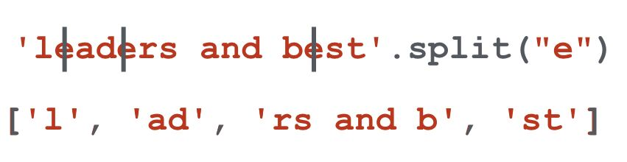
Example
song = "The rain in Spain..."
wds = song.split('ai')
print(wds)

Slide 78
String Functions
Split()
>>> string='192.168.001.001'
>>> string.split('.')
['192', '168', '001', '001']
>>> ip = string.split(".")
>>> print(ip)
['192', '168', '001', '001']
>>>

Slide 79
Parsing and Extracting
19
31
From alicihan.keles@hotmail.com Thu March 19 05:05:15 2020
>>> data = 'From alicihan.keles@hotmail.com Thu March 19 05:05:15 2020'
>>> atpos = data.find('@')
>>> print(atpos)
19
>>> sppos = data.find(' ',atpos)
>>> print(sppos)
31
>>> host = data[atpos + 1 : sppos]
>>> print(host)
hotmail.com

Slide 80
Two Kinds of Strings
Python 2.7.10
>>> x = '이광춘'
>>> type(x)
<type 'str'>
>>> x = u'이광춘'
>>> type(x)
<type 'unicode'>
>>>
Python 3.8.1
>>> x = '이광춘'
>>> type(x)
<class 'str'>
>>> x = u'이광춘'
>>> type(x)
<class 'str'>
>>>
In Python 3, all strings are Unicode

Slide 81
Summary
This chapter covered:
  String operations, including:
    Methods for iterating over strings
    Repetition and concatenation operators
    Strings as immutable objects
    Slicing strings and testing strings
    String methods
    Splitting a string

Slide 82


Acknowledgements / Contributions
These slides are Copyright 2010- Charles R. Severance (www.dr-chuck.com) of the University of Michigan School of Information and open.umich.edu and made available under a Creative Commons Attribution 4.0 License. Please maintain this last slide in all copies of the document to comply with the attribution requirements of the license. If you make a change, feel free to add your name and organization to the list of contributors on this page as you republish the materials.
Initial Development: Charles Severance, University of Michigan School of Information
… Insert new Contributors and Translators here
...

